Slide 1
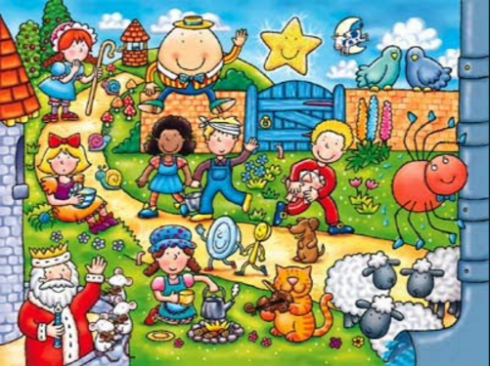
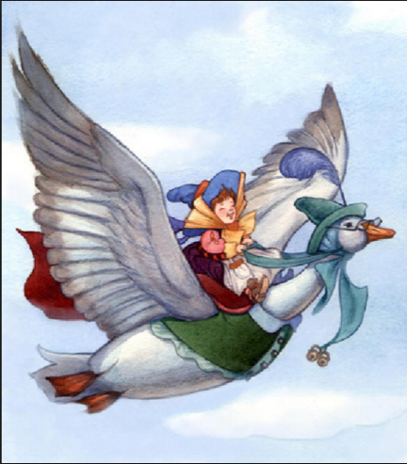
Nursery Rhymes Song

Slide 2
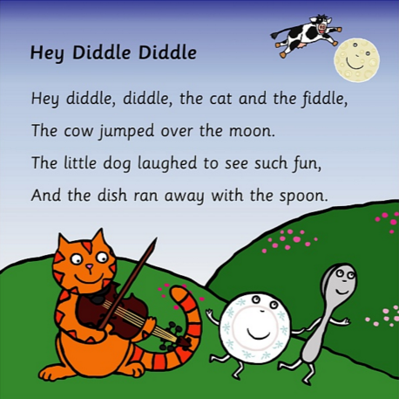

Slide 3
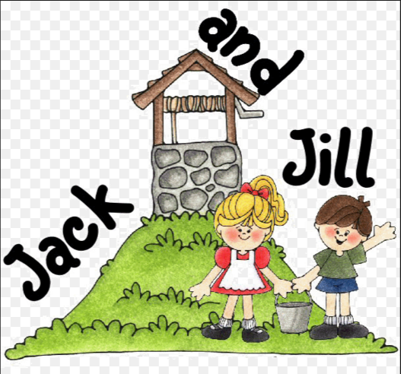
Jack and Jill went up a hill to fetch a pail of water.
Jack fell down and broke his crown and Jill came tumbling after.

Slide 4
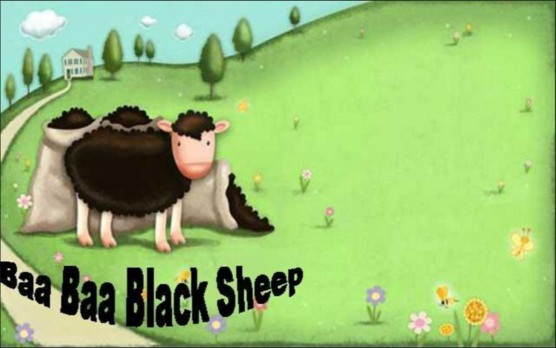
Baa, Baa, Black Sheep
Have you any wool?
Yes, sir! Yes, sir!
Three bags full.

Slide 5
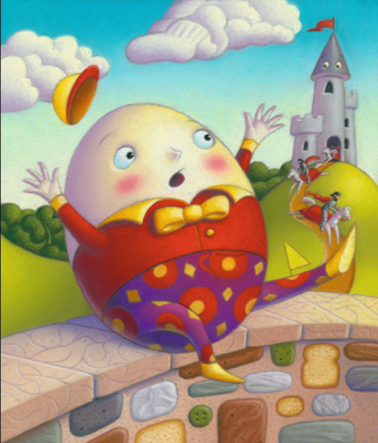
Humpty Dumpty sat on a wall. Humpty Dumpty had a great fall. All the king’s horses and all the king’s men couldn’t put Humpty together again.

Slide 6
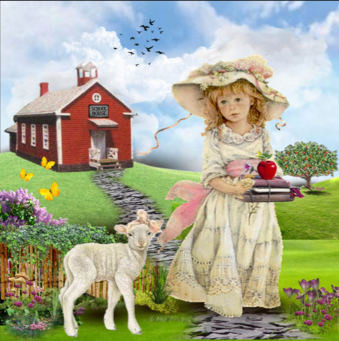
Mary had a little lamb whose fleece was white as snow.
And everywhere that Mary went, her lamb was sure to go.

Slide 7
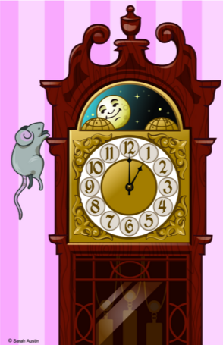
Hickory, dickory dock.
The mouse ran up the clock.
The clock struck one.
The mouse ran down.
Hickory, dickory, dock.

Slide 8
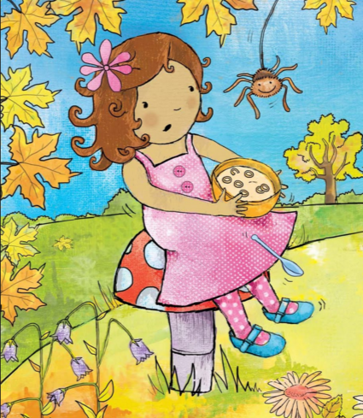
Little Miss Muffet sat on a tuffet eating her curds and whey.
Along came a spider who sat down beside her and frightened Miss Muffet away!

Slide 9
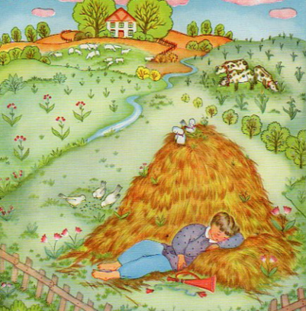
Little Boy Blue, come blow your horn.
The sheep’s in the meadow.
The cows in the corn.
But where’s the boy who looks after the sheep?
He’s under the haystack fast asleep.

Slide 10
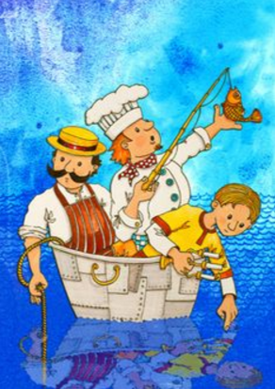
Rub a dub dub.
Three men in a tub.
And who do you think they be?
The butcher, the baker, the candlestick maker.
They all sailed out to sea.

Slide 11
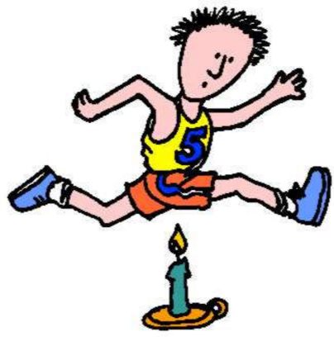
Jack be nimble.
Jack be quick.
Jack jumped over the candlestick.
Jack be nimble.
Jack be quick.
Jack jumped over the candlestick.

Slide 12
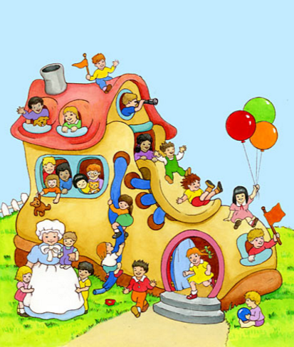
There was an old woman who lived in a shoe.
She had so many children she didn’t know what to do.
She gave them some broth without any bread.
Then spanked them all soundly and sent them to bed.

